Slide 1

Women Investing In Real Estate W.I.R.E is Fire
NAREB National Meeting 2025
Notes:
Fix how wording

Slide 2

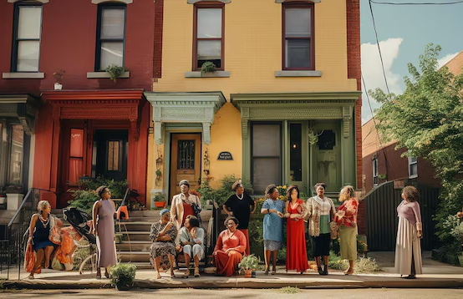
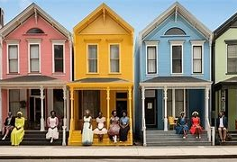
Community
As important now as it was in the past
Sharing data and information to measure opportunities, needs, and progress
Assisting in employment opportunities, financing and ability to purchase a home
Community doesn’t end there, it continues after closing
Helping buyer get through the first several critical years
Protections of community established by the Federal Government may no longer be available

Slide 3
Previous Census Findings
Over the past 4 years we have been honored to speak with you; sharing the data that focus on black women and all the facets of her community. Source of data used by decisions-makers regarding our needs, wants and ability to pay.
What we learned from the Census
Population numbers regarding the African American female: current and projected
Age, with regards to buying power
Data on her education…growing in Jr. College, Technical College, Professional programs
Annual Income and sources…increasing numbers in entrepreneurial
Household composition /family responsibilities

Slide 4

Previous HMDA Findings
HMDA Data -mortgage disclosure act data assesses whether lenders are serving the housing needs of their communities.
Information Learned from Mortgage Data (HMDA)
Number of Loan originations since 2007
Loan types
Age of applicants
Marital status
Level of acceptance and reasons for denials
Debt-to-income ratios

Slide 5
Previous Policy Implications
Housing and Wage policies were not created with African American Women and their communities in mind. In addition to numbers, we have discussed issues such as:
Housing Policies and their impact on African American women
Economic uncertainty on the housing market: interest rates, housing building supplies and housing stock
Impact of the pandemic on African American women
Preserving heirship property
Preventing foreclosure
Preserving fair housing protections
Preserving special purpose credits
Establishing family trusts for wealth preservation
Gaining a seat at decision-making tables: national, state, regional, city and/or neighborhood

Slide 6
Emerging and Existing Trends
Impacting the African American Woman

Slide 7

Positive Aspects of AI for African American Women
McKinsey Institute for Economic Mobility reports that AI could provide equitable benefits for Black and other marginalized communities and accelerate the closure of the racial gap.
Eight benefits are financial inclusion, credit and ecosystem development for small businesses, health, workforce and jobs, preK-12 education, the digital divide, affordable housing, and public infrastructure.
Incorporating AI into prenatal care has reduced pre-term births, based on a study described in a Harvard Business Review.

Slide 8
Positive Aspects of AI For African American Women
AI can increase equity by enhancing access to banking products for Back Americans, who have historically faced exclusion from financial products and services.
AI can achieve financial inclusion by generating targeted, responsive marketing content and specific personalized offerings.
Leaders with influence must build equity in developing AI strategies that promotes inclusion, fairness and opportunity.

Slide 9

Artificial Intelligence (AI) Bias Can Impact Home Loan Approval
45% of the country’s largest mortgage lenders now offer online or app-based loan origination.
Disparities in homeownership rates are cited as the leading cause in the racial wealth gap.
AI could help reverse this trend by eliminating discrimination by loan officers.
AI systems trained on biased data that perpetuate stereotypes and discrimination should be fed unbiased data and regulated to mitigate negative impacts on minority populations.

Slide 10

Emerging Trends - DOGE
Job cuts by the Department of Government Efficiency have disproportionately affected Black federal workers.
A Pew report finds that Black workers represent 18.5% of the federal workforce of Black workers compared to 12% of the civilian population.
The Civil Rights Act of 1964 made the federal government the standard for fair hiring practices.
Most federal jobs offer career protections such as retirement benefits, savings plans and pensions.
Federal “laid-off” workers will face a competitive market.

Slide 11
Federal Layoffs and Impacts on Our Community
According to the National Women’s Law Center, Women and people of color are among those most affected by cuts to certain agencies.
Women made up the majority of workers in Veteran Affairs, Education, Health and Human Services, Treasury and Housing and Urban Development, U.S. Agency for International Development (USAID), the Consumer Financial Protection Bureau and Voice of America.
The federal career ladders that these women had relied on has been canceled.
The DOGE cuts may impact the pay gap for women and particularly women of color.

Slide 12
Lack of Data on Lay Offs
The White House recently removed current and historic diversity data from public government websites, preventing media organizations and watchdog groups from determining exact numbers and impact of mass terminations.

Slide 13
The Wealth Gap and its Impact on Our Community
The authors of Fifteen Cents on the Dollar state “there is no long-running government dataset available to study wealth over the history of the United States, helping to create a gap in the public conversation about wealth.”
As of 2022, for every dollar held by the typical white family, the typical Black family had 15.5 cents, an 84.5 cent gap.
As a result, we have far less to build wealth in our communities

Slide 14
The Cost of TARIFFS on African American Women
Many of the Black hair products that are imports from China will rise
It will cost more to fill your car’s gas tank
The cost of diapers will increase
Cleaning supplies will cost more
Cost of raw materials imported for hair products developed in the US will rise
This will impact:
Entrepreneurial African American Women
Economically marginalized African American Women
Notes:
Redo slide with ‘hair products’

Slide 15
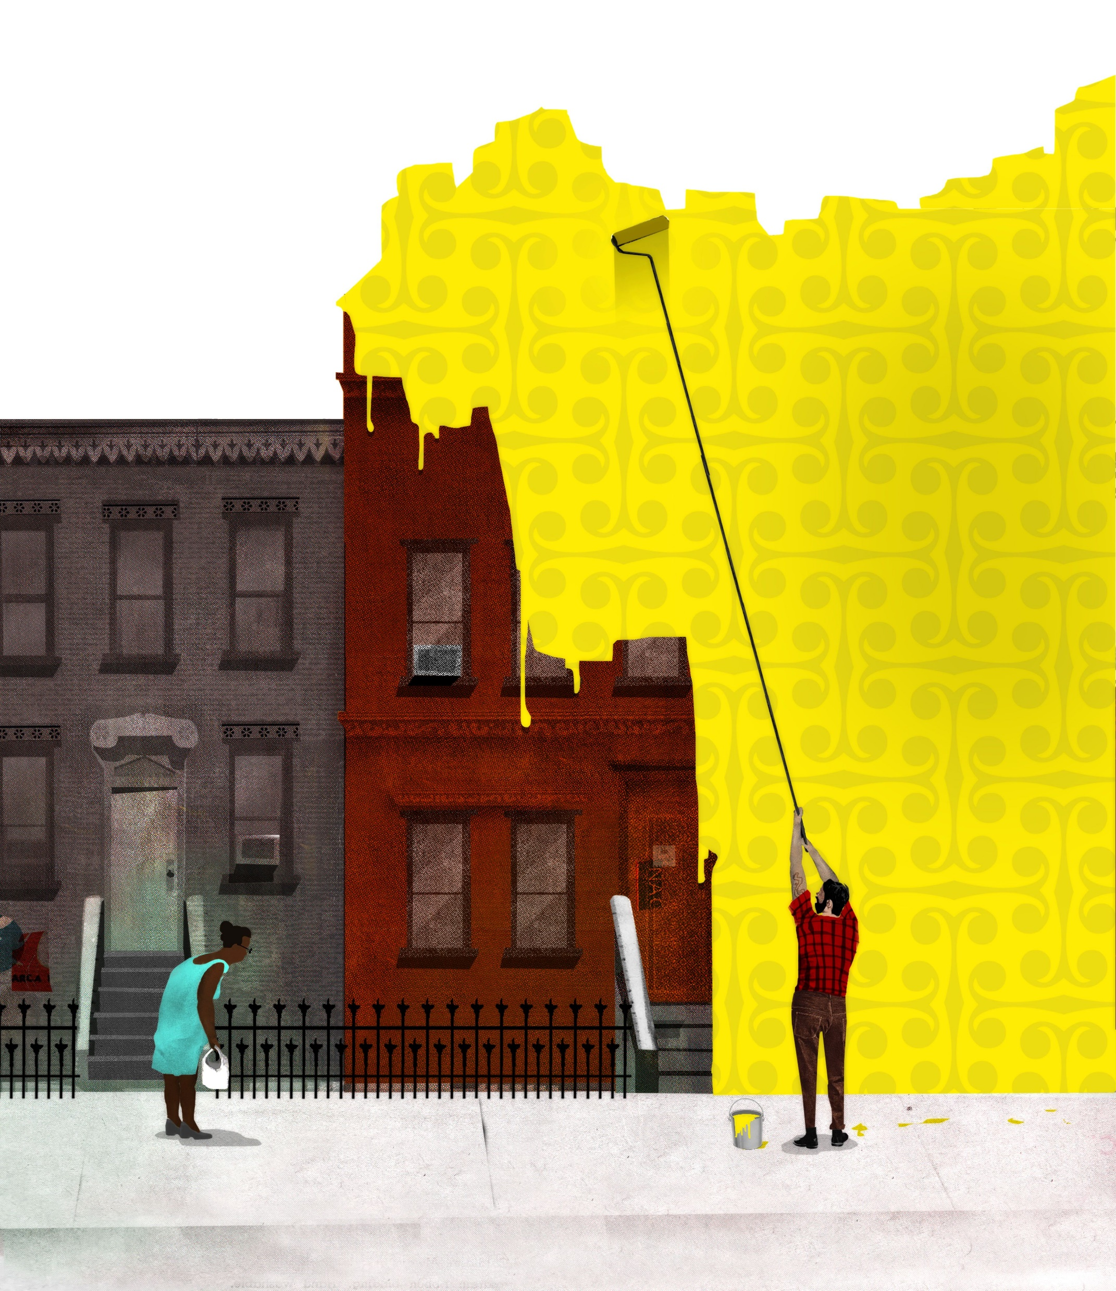
Gentrification a Trend that Impacts Communities
gentrification, is a process in which wealthier, privileged, typically white individuals move into neighborhoods that are largely populated by poor and working-class residents who are frequently and predominantly people of color, the newcomers ultimately displacing the original residents.

Slide 16

Gentrification Affects on Communities
Lower-income communities are the most vulnerable to gentrification.
The rising cost of living, escalating rents and mortgages, stagnant wages, and gender wage-gap force them out of their neighborhoods, despite many having community ties for multiple generations.
Many times, the issue with gentrification is not that it harms African American neighborhoods but that it may fail to include the residents in the changes that occur because of gentrification.

Slide 17
Gentrification Can Preserve Wealth in Communities
For African Americans selling their homes in newly gentrified cities amid new land development, it is likely to cause a decrease in your overall wealth. Home values often increase as more amenities are added to the neighborhood.
The investment of homeownership can only be preserved for future generations if the property remains in the family. Protecting your home through creating a will, estate planning, and trusts protects generational wealth.

Slide 18
Impacts of Emerging Trends
Notes:
What do the trends mean or, what is the impact of these trends. There are many facets of our lives that the trends potentially impact. As we focus those impacts to investing in real estate, there are two terms that should keep in the forefront of your mind: resilience and sustainability

Slide 19

What Does this Mean for African American Women ?
If African American Women falter in skills, education, earnings jobs and wealth building through homeownership, the entire Black Community will suffer.
But African American Women have always been resilient.
Resilience!

Slide 20
Originations: Successful Loan Applications
Year | No. of applications | Percent approved
2018 | 303,470 | 0.48
2019 | 345,553 | 0.51
2020 | 452,405 | 0.54
2021 | 562,224 | 0.56
2022 | 406,946 | 0.49
2023 | 293,051 | 0.48
2024 | 308,744 | 0.48

Slide 21
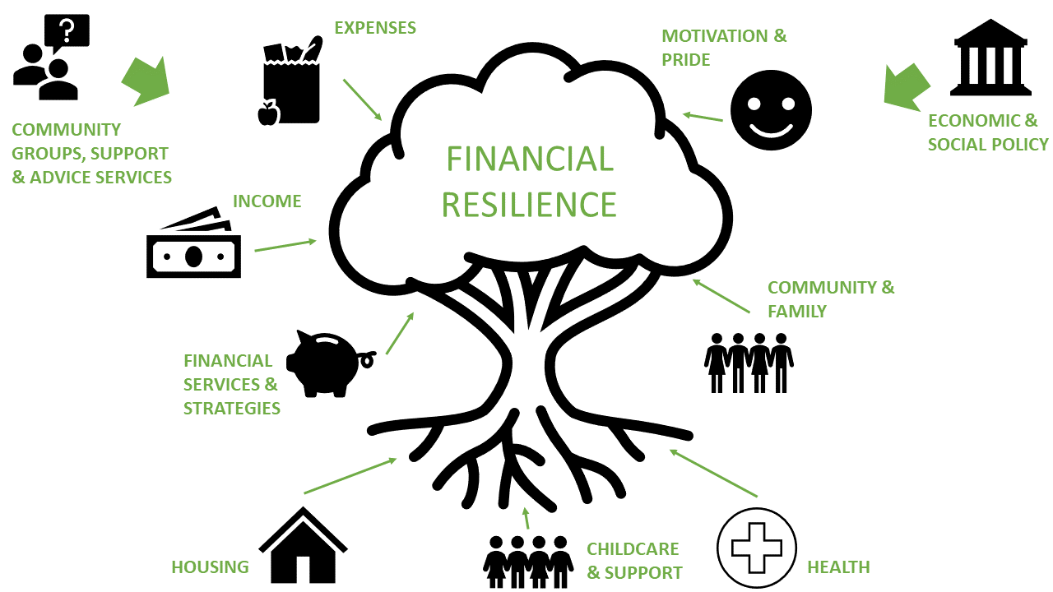
Resiliency – Debt-to-Income Ratio
Financial Resiliency: ability to bounce back from life-altering setbacks that impact our personal finances; ability to withstand money pressures
 |  | Asian | Black | Hispanic | HoPi | Native Amer | White
 | <20% | 0.04 | 0.02 | 0.02 | 0.03 | 0.04 | 0.04
 | 20%-<30% | 0.12 | 0.08 | 0.08 | 0.09 | 0.11 | 0.14
 | 30%-<36% | 0.14 | 0.12 | 0.11 | 0.12 | 0.14 | 0.16
 | 36%-<44% | 0.31 | 0.31 | 0.30 | 0.28 | 0.33 | 0.32
 | 44%-<50% | 0.33 | 0.30 | 0.36 | 0.33 | 0.28 | 0.27
 | 50%-60% | 0.06 | 0.15 | 0.13 | 0.14 | 0.10 | 0.07
 | >60% | 0.01 | 0.01 | 0.01 | 0.01 | 0.01 | 0.01
Notes:
Our debt-to-income ratios tells us how much of our monthly income (gross) is a committed to some type of payment – including mortgages.

Slide 22

African American Women Can Build Wealth Through Real Estate
Real Estate is an investment that can yield significant returns over time.
Real Estate can be passed down through generations.
Real estate provides a level of stability compared to more volatile markets like stocks because of its tendency to appreciate over time.
Paying down the mortgage builds equity that strengthens your financial position and can be leveraged for further investment, serving as a stepping-stone to greater financial prosperity.
Notes:
Change this picture

Slide 23

African American Women Can Build Wealth Through Real Estate
Real Estate can provide a comfortable retirement, covering living expenses.
During challenging economic times, real estate can be a resilient asset, offering a shield against the damaging effects of inflation. As the cost –of- living increases, often property values and rental incomes also increase.
Real Estate has a variety of tax advantages from deductions on mortgage interest to depreciation benefits.

Slide 24
Loan-To-Value: It’s an Equity Issue
 |  | Avg. Loan Amount | Avg. Property Value | Loan-to-value
 | Grand Total | 230,165 | 421,188 | .55
 | Black | 221,025 | 347,472 | .64
 | Hispanic | 243,457 | 400,652 | .61
 | White | 210,145 | 414,205 | .51
African American women have the highest loan to value ratios
They purchase homes with the lowest values. Yet, they have taken out the second highest loan amounts.

Slide 25
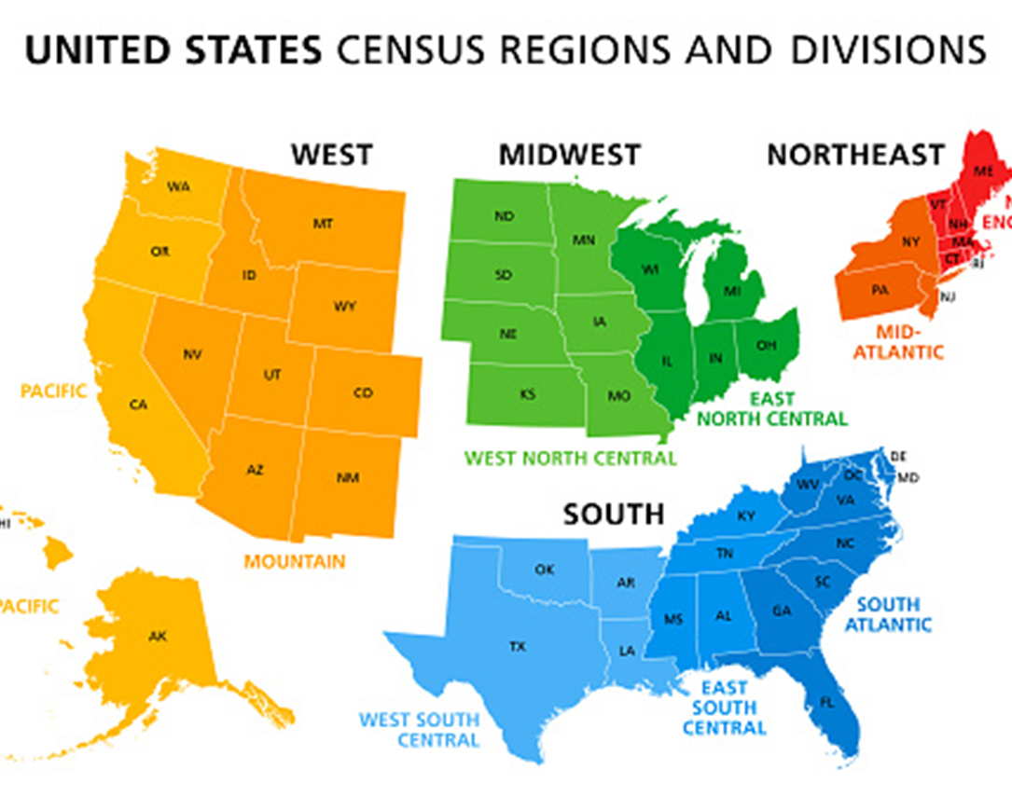

Slide 26

West in 2024
Number of applications: 55,305
Origination rate: 26,640 (48%)
Loan Amount: $343,467
Housing Value: $592,886
Loan-to-Value: 58%

Slide 27
Mid-west in 2024
Number of applications: 21,066
Origination rate: 10,523 (50%)
Loan Amount: $163,585
Housing Value: $224,422
Loan-to-Value: 73%

Slide 28
South in 2024
Number of applications: 193,834
Origination rate: 95,001 (49%)
Loan Amount: $229,541
Housing Value: $318,066
Loan-to-Value: 72%

Slide 29
Northeast in 2024
Number of applications: 36,628
Origination rate: 17,107 (47%)
Loan Amount: $242,070
Housing Value: $315,359
Loan-to-Value: 77%

Slide 30
Moving From Single to Multi-Family Ownership
Single family housing isn’t the only way for women to invest in real estate. We’ve never looked at this before but let’s look at multi-family.
 | AA Women | Total persons of color | Percent female ownership
Total Units | 670 | 2,208 | 0.23
5-24 | 648 | 2,079 | 0.24
25-49 | 7 | 88 | 0.07
50-99 | 5 | 21 | 0.19
100-149 | 3 | 9 | 0.25
>149 | 7 | 11 | 0.39

Slide 31

Community Conversation: African American Women Must Know How to Maintain Generational Wealth
Over the next two decades, $68 trillion dollars is expected to move from Baby Boomers to their Gen X and Millennial children and grandchildren.
Boomers now hold more than half of all wealth in the U.S. compared to just 3% held by Millennials, indicating that a transfer of knowledge may be required to help the inheriting generations manage their new-found wealth.

Slide 32
Community Conversation: African American Women Must Know How to Maintain Generational Wealth
Family financial meetings can be a time to discuss legacy plans and learn where each person is in terms of financial literacy, identifying areas that family members need help in building skills to manage wealth confidently and competently. a
If an heir is not yet able to responsibly manage wealth, you might set up a trust to handle their inheritance.
This may include simple budgeting, understanding economic indicators and how to track them, investing, estate planning and tax knowledge.

Slide 33

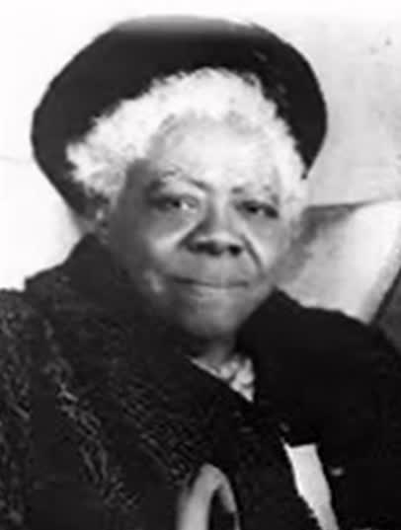
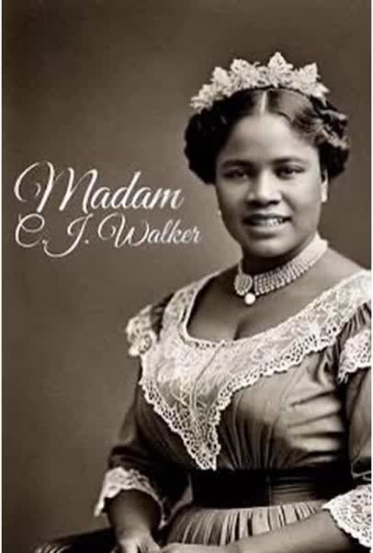
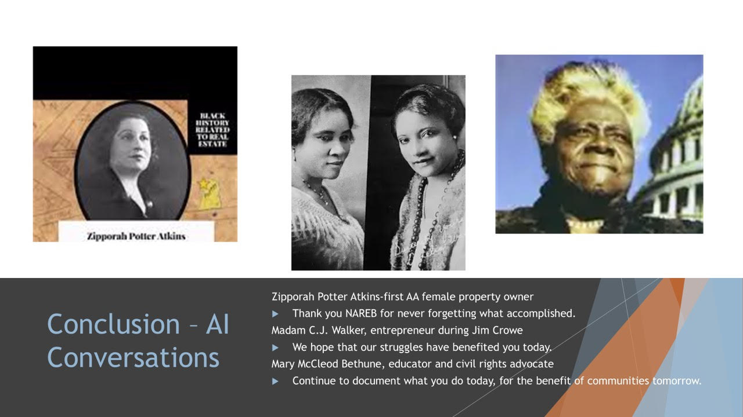



Mary McCleod Bethune
Madam C.J. Walker
Zipporah Potter Atkins
Entrepreneur
during jim crow
First African American Female
Property Owner
educator and
civil rights advocate

Slide 34
Thank You

